Slide 1
Machine Learning
A Battery-grid Integration by Machine Learning Approach
Name:- Hardik Bhadru
Enrollment No:-91900133054

Slide 2
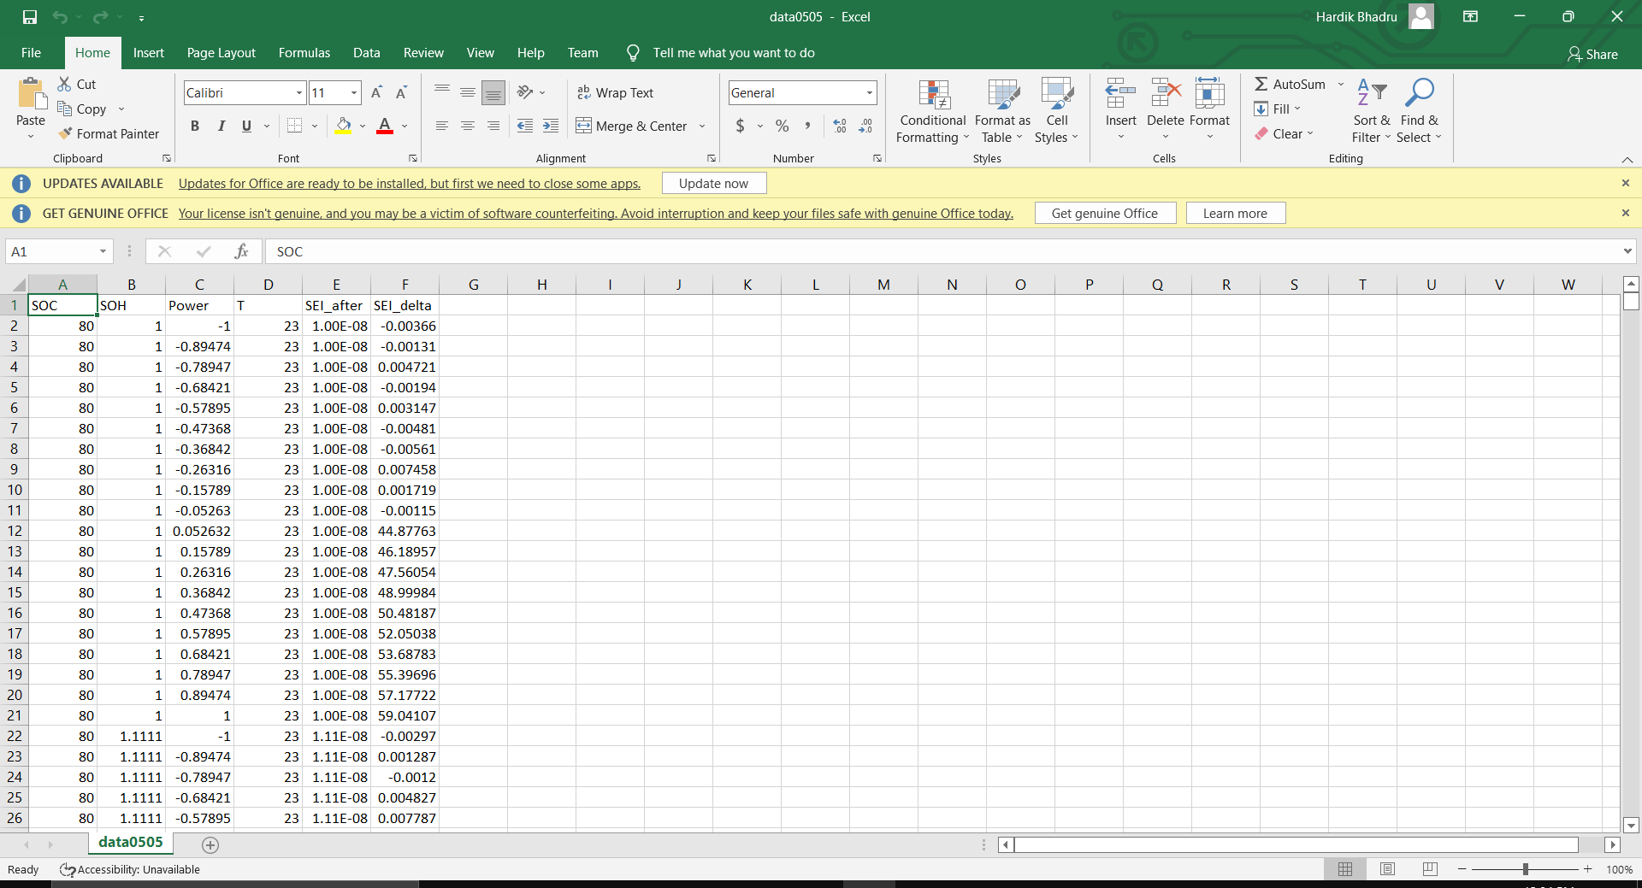
Dataset

Slide 3
Feature Of dataset / Predict data
SOC (State of charge)
SOH(State of health)
Power (Power of the battery)
SEI_delta (solid-electrolyte interphase)

Slide 4
Gird Failure Event
Primary Reserve
Secondary Reserve
Grid Frequency (Hz)
Nominal value (60Hz in the USA)
Stop the
frequency drift
Get the frequency back to the normal
eg. Generators
eg. Batteries
Time (min)

